Slide 1
Fourier Transform
CSCI 4150/6050: Computer Vision
Slides by Dr. Bryan Morse from BYU

Slide 2
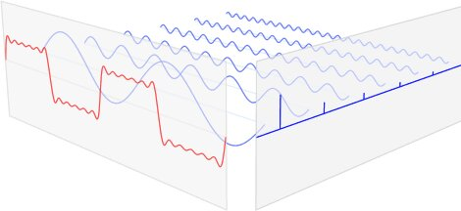
Frequency Domain
Key Idea: Any periodic function can be recreated as a sum of sine waves.
A digital signal can be represented by storing the amount of each sine-wave frequency needed.
This is called representing the function in the frequency domain.
The Fourier Transform converts a signal into frequency coefficients.
Signal
Frequency
Domain
https://www.ritchievink.com/blog/2017/04/23/understanding-the-fourier-transform-by-example/

Slide 3
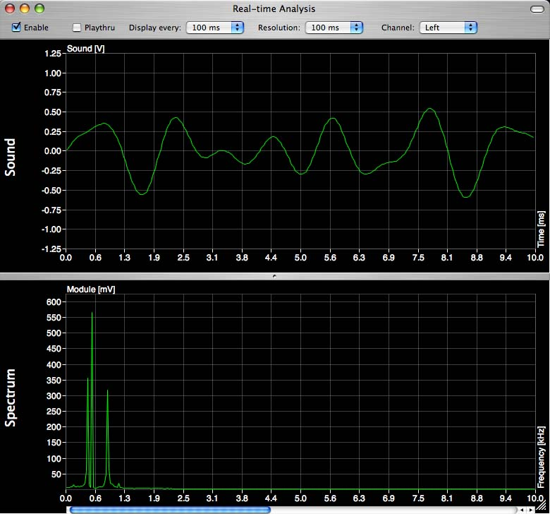
Time Domain vs. Frequency Domain
For sampled functions of time, we talk about manipulating these samples in the time domain
Earlier in the semester, we learned ways to manipulate images in the spatial domain
Let’s talk about manipulating them in the frequency domain

Slide 4
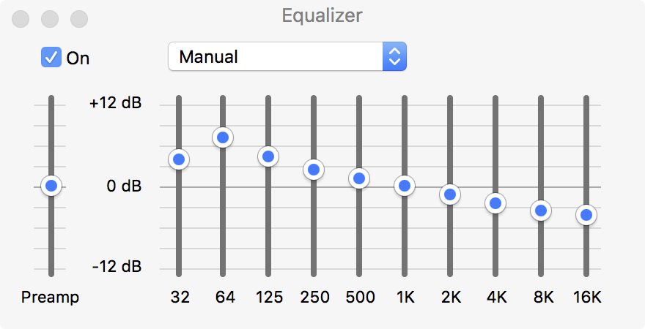
Frequency-Domain Processing
The simplest way to process signals in the frequency domain is to
  Selectively amplify (boost)
  certain frequencies
  Selectively attenuate (weaken) other frequencies

Slide 5
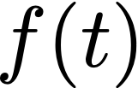
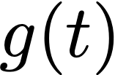
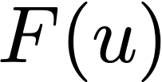
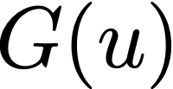
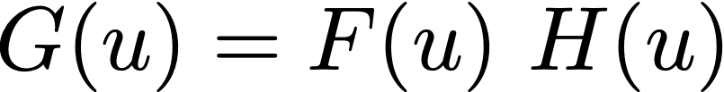
Common Notation
Time
Domain
Input
System
Output
Frequency
Domain
“Transfer Function”

Slide 6
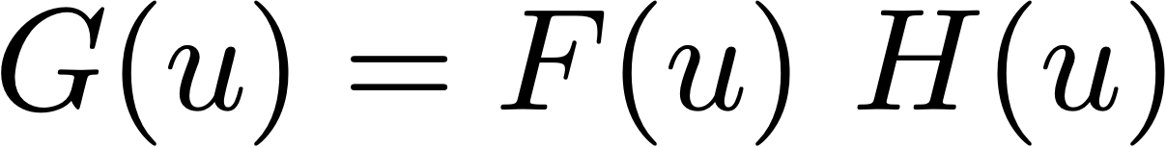
The Transfer Function
Intuition: how different frequencies “transfer” from input to output
Remember:
  Input F(u) is complex
  Output G(u) is also complex
If transfer function H(u) is real-valued, it multiplies both the real (cosine) part and the imaginary (sine) part equally
  Magnitude/amplitude is scaled
  (amplification/attenuation)
  Phase is left unchanged

Slide 7
The Transfer Function
If H(u) is complex-valued, it multiplies the real (cosine) part and the imaginary (sine) part differently
  The magnitudes multiply
  (amplification/attenuation)
  The phases add
  (shifts different frequencies potentially differently)

Slide 8
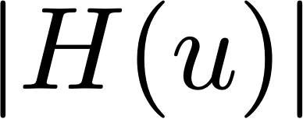
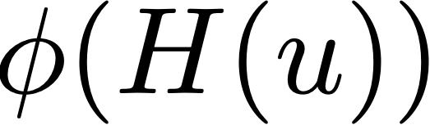
The Transfer Function
Modulation Transfer Function
Phase Transfer Function
Selectively amplifies/attenuates
Selectively shifts different frequencies

Slide 9
Filtering
Designing and applying a transfer function to a signal in the frequency domain it is called filtering
You can design H(u) to be whatever you want it to be!

Slide 10
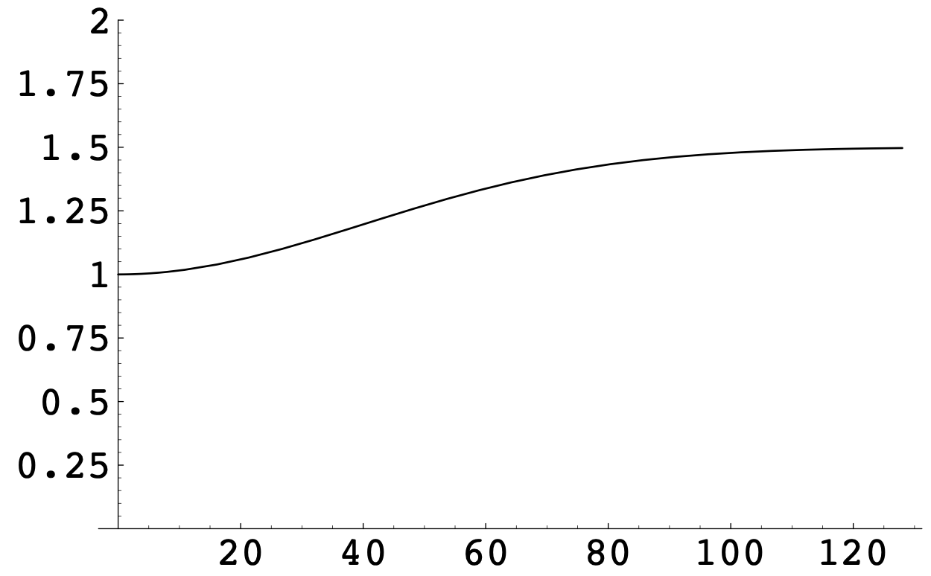
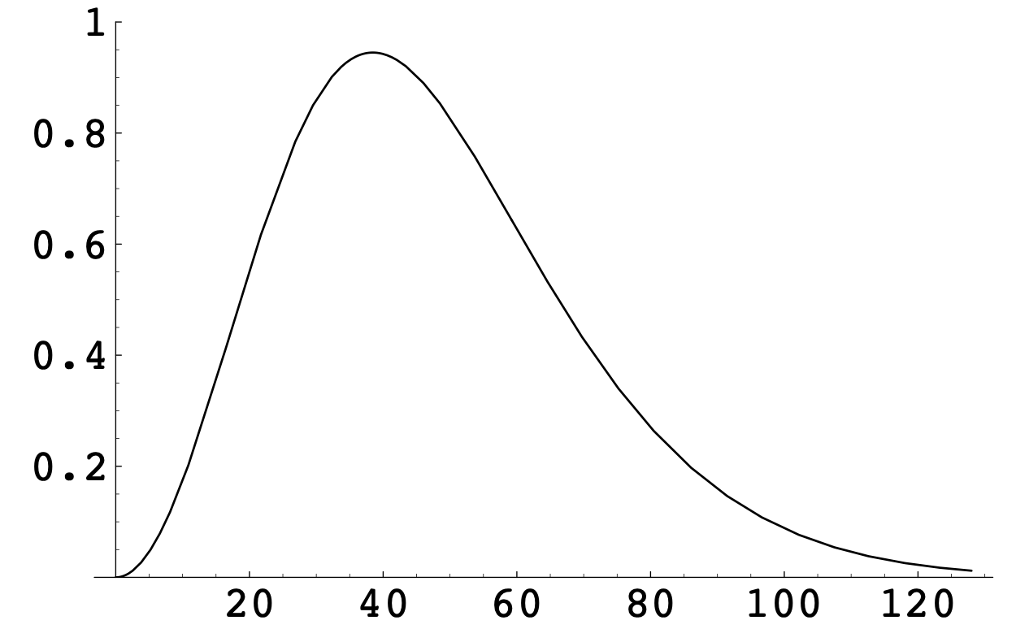
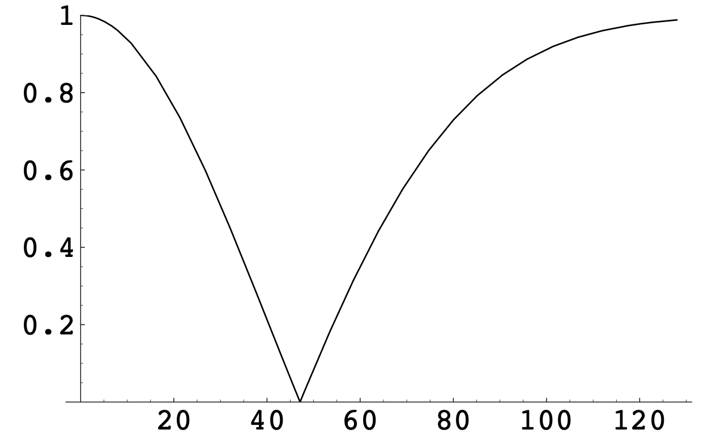
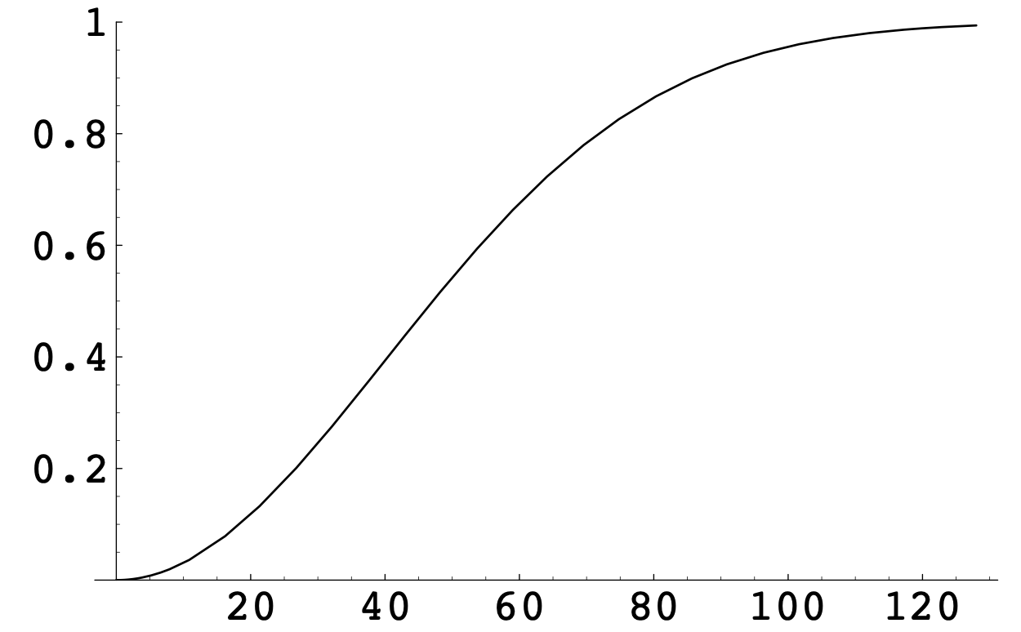
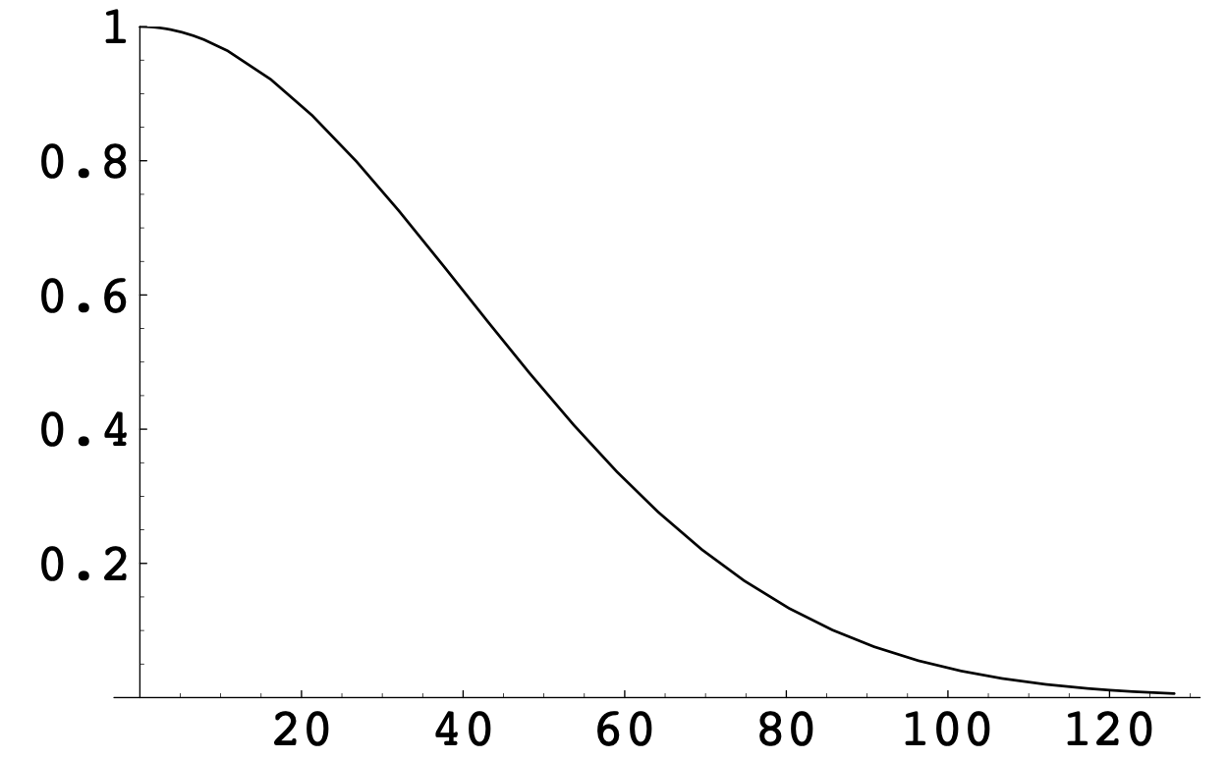
Types of Filters
Low-Pass | Keeps low frequencies, attenuates higher ones
High-Pass | Keeps high frequencies attenuates lower ones
High-Boost | Keeps lower frequencies, boosts higher frequencies
Band-Pass | Attenuates frequencies above or below a target band
Band-Suppress | Attenuates frequencies in a target band

Slide 11
Low-Pass Filters
Lets low frequencies pass through
Attenuates higher frequencies
Examples:
  Sound through air
  Sound through other materials
  RF signals through air
  Electronic signals through wire

Slide 12
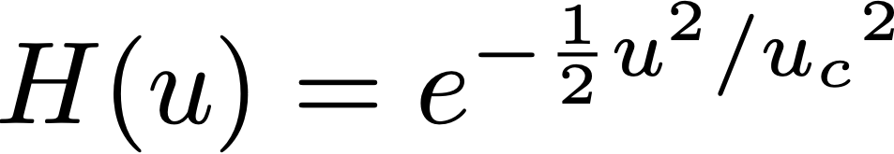
Example: Gaussian Low-Pass Filter
One common form of a low-pass filter is the Gaussian
Cutoff frequency

Slide 13
High-Pass Filters
Lets high frequencies pass through
Attenuates lower frequencies
Not very common in nature but useful in electronics or signal processing
Often 1.0 minus a low-pass filter

Slide 14
High-Boost Filters
Boosts high frequencies
Useful for “undo-ing” low-pass filters
Can boost any other part of the frequency domain as well
Often 1.0 plus a high-pass filter

Slide 15
Band-Pass Filters
Lets frequencies in some target band pass through
Attenuates higher/lower frequencies
Eg., difference of two low-pass filters

Slide 16
Band-Suppresses Filters
Suppresses frequencies in a target band
Preserves higher/lower frequencies

Slide 17
Phase Filtering
Time delay
Example: transmission of electronic signals through wires
  Different frequencies pass at different speeds through the same media
  Can become noticeable over long distances
  Solution: periodically gather, re-sync the phases, retransmit

Slide 18
Implementing Filtering Digitally
Time-Domain Input
Time-Domain Output
FFT
Inv. FFT
Multiply by filter

Slide 19
Key Ideas So Far…
Any 1-D signal can be decomposed into a weighted sum of sines and cosines of different frequencies
Fourier Transform: a mathematical process for doing this decomposition
Discrete Fourier Transform (DFT): a mathematical process / algorithm for computing the Fourier Transform of sampled signals
Fast Fourier Transform (FFT): an algorithm that computes the DFT faster
Once the Fourier Transform of a signal has been computed, we can manipulate it by multiplying by a filter in the frequency domain and converting back to the time domain
Filters come in different kinds: low-pass, high-pass, band-pass, high-boost, etc.

Slide 20
If we can represent a 1-D function into a weighted sum of other 1-D functions, can we represent images as a weighted sum of other images?

Slide 21
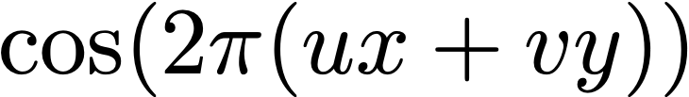
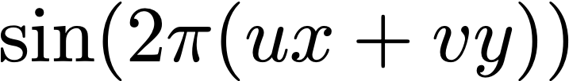
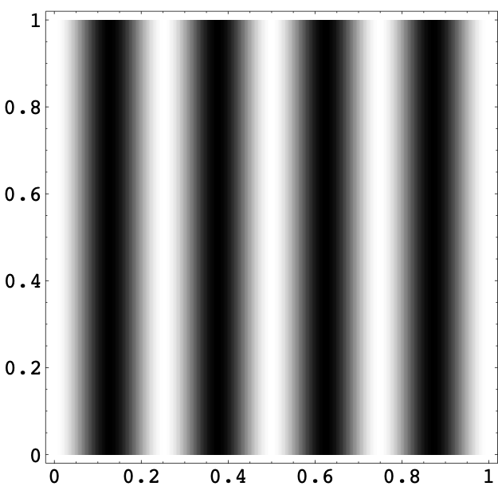
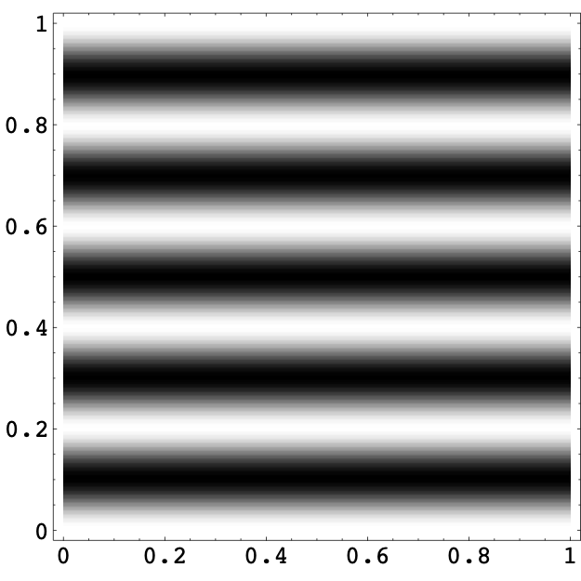
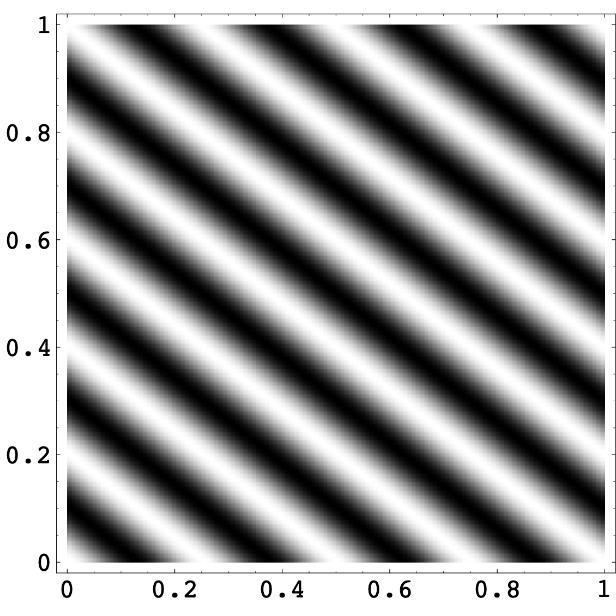
The 2D Fourier Transform
Uses basis functions of two variables
  u = frequency in the x direction
  v = frequency in the y direction
u = 4, v = 0
u = 0, v = 5
u = 4, v = 5

Slide 22
The 2D Fourier Transform
1-D:
2-D:

Slide 23
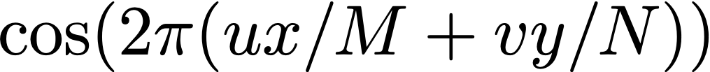
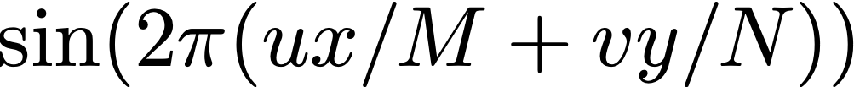
The 2D Discrete Fourier Transform
Uses basis functions of two variables
  u = frequency in the x direction
  v = frequency in the y direction
For an N x M image:
u = 4, v = 0
u = 0, v = 5
u = 4, v = 5

Slide 24
The 2D Discrete Fourier Transform
Example: 64 basis images can be combined in a weighted sum to form any 8 x 8 image
* Technically, these are for the DCT, a close cousin to the DFT

Slide 25
Spatial Frequencies
We call these different image components “spatial frequencies”
Analogous to 1-D frequencies like audio
Intuition:
  low frequencies are slow, gradual changes
  high frequencies are rapid changes (e.g., textures, edges)

Slide 26
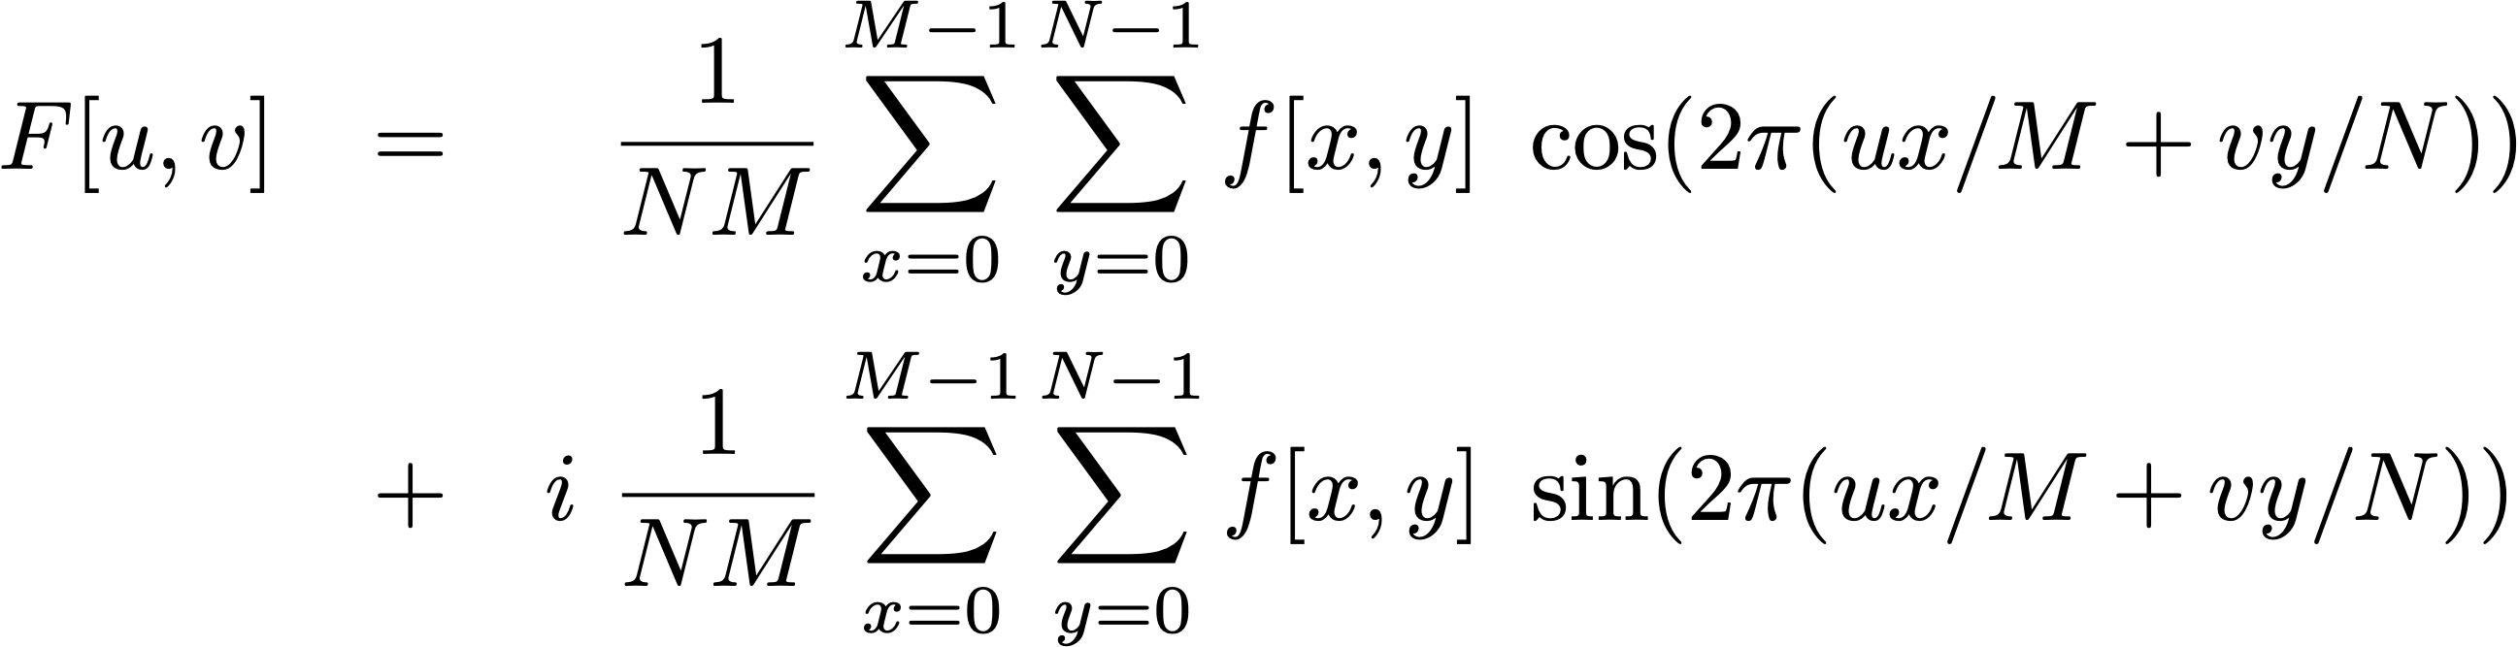
The 2D Discrete Fourier Transform
What’s does the code look like?
What’s the computational complexity?

Slide 27
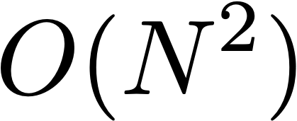
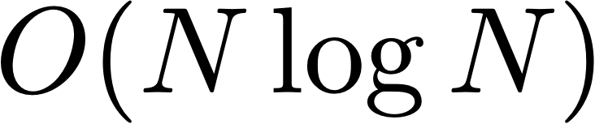
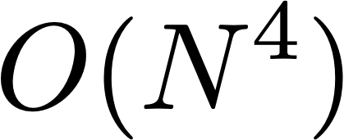
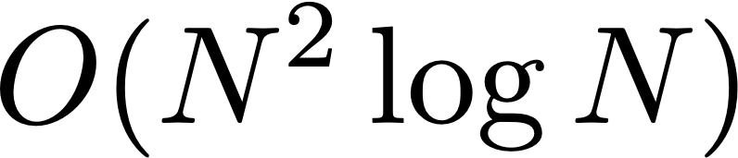
The 2D Fast Fourier Transform
DFT
FFT
1-D
2-D

Slide 28
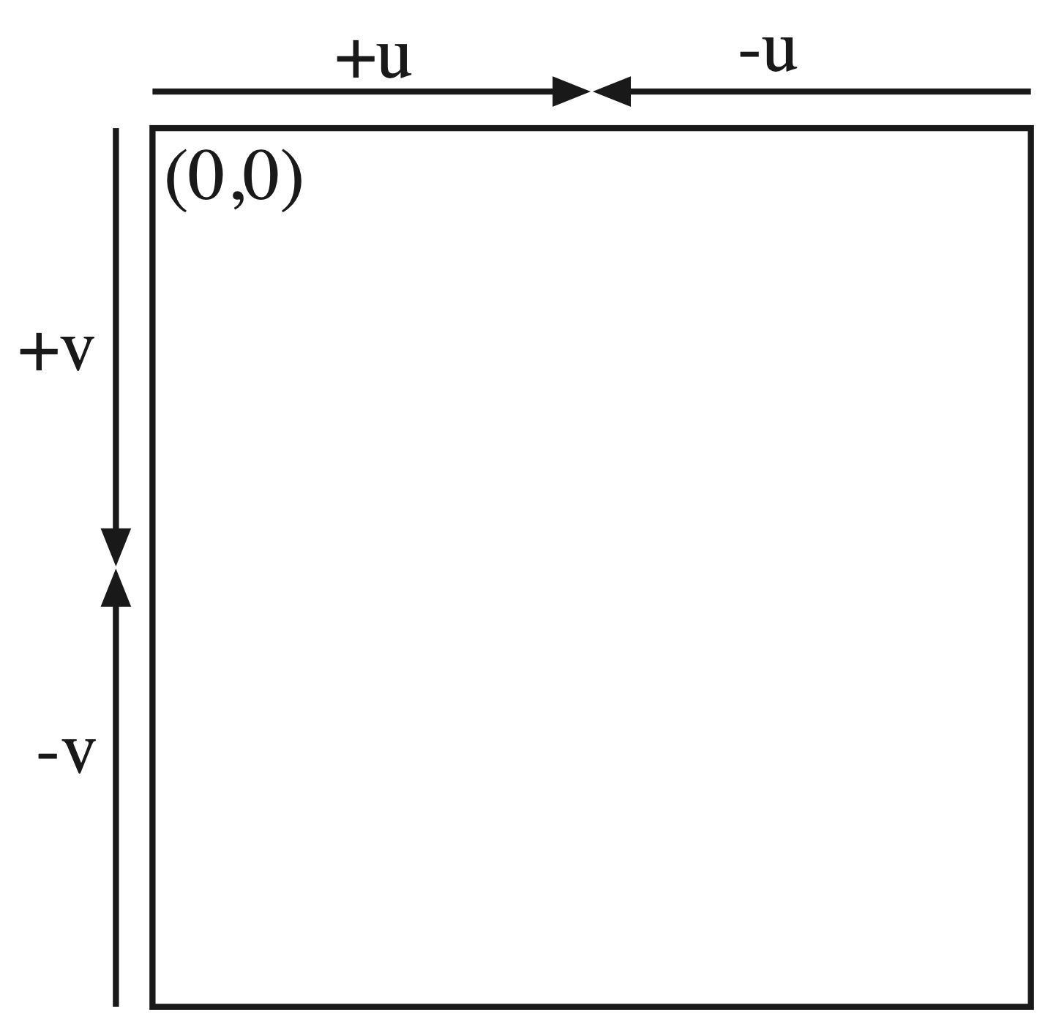
2D DFT Storage
(like 1-D, it’s often useful to shift it to better visualize)

Slide 29
Interpreting the 2D DFT
Frequencies in x and y directions
  u = frequency in the x direction
  v = frequency in the y direction
A sinusoidal pattern in a single direction
Useful property: rotating the image rotates its Fourier Transform
u = 4, v = 5

Slide 30

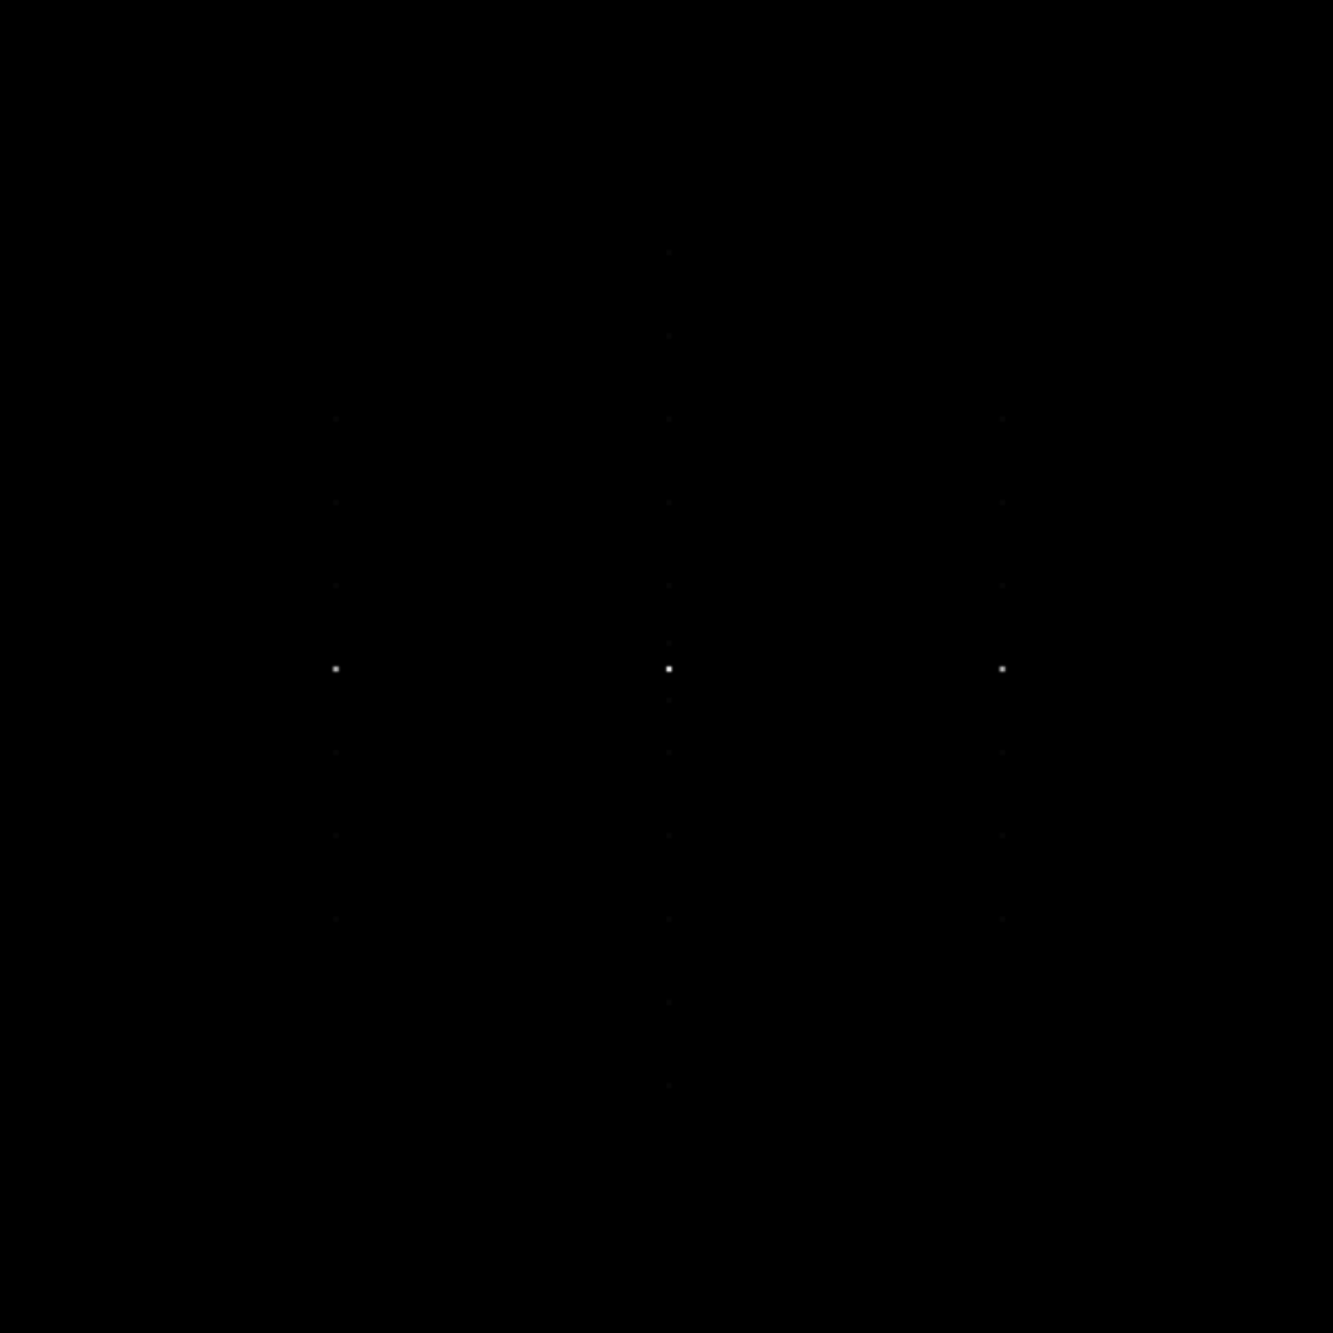
Examples

Slide 31


Examples

Slide 32
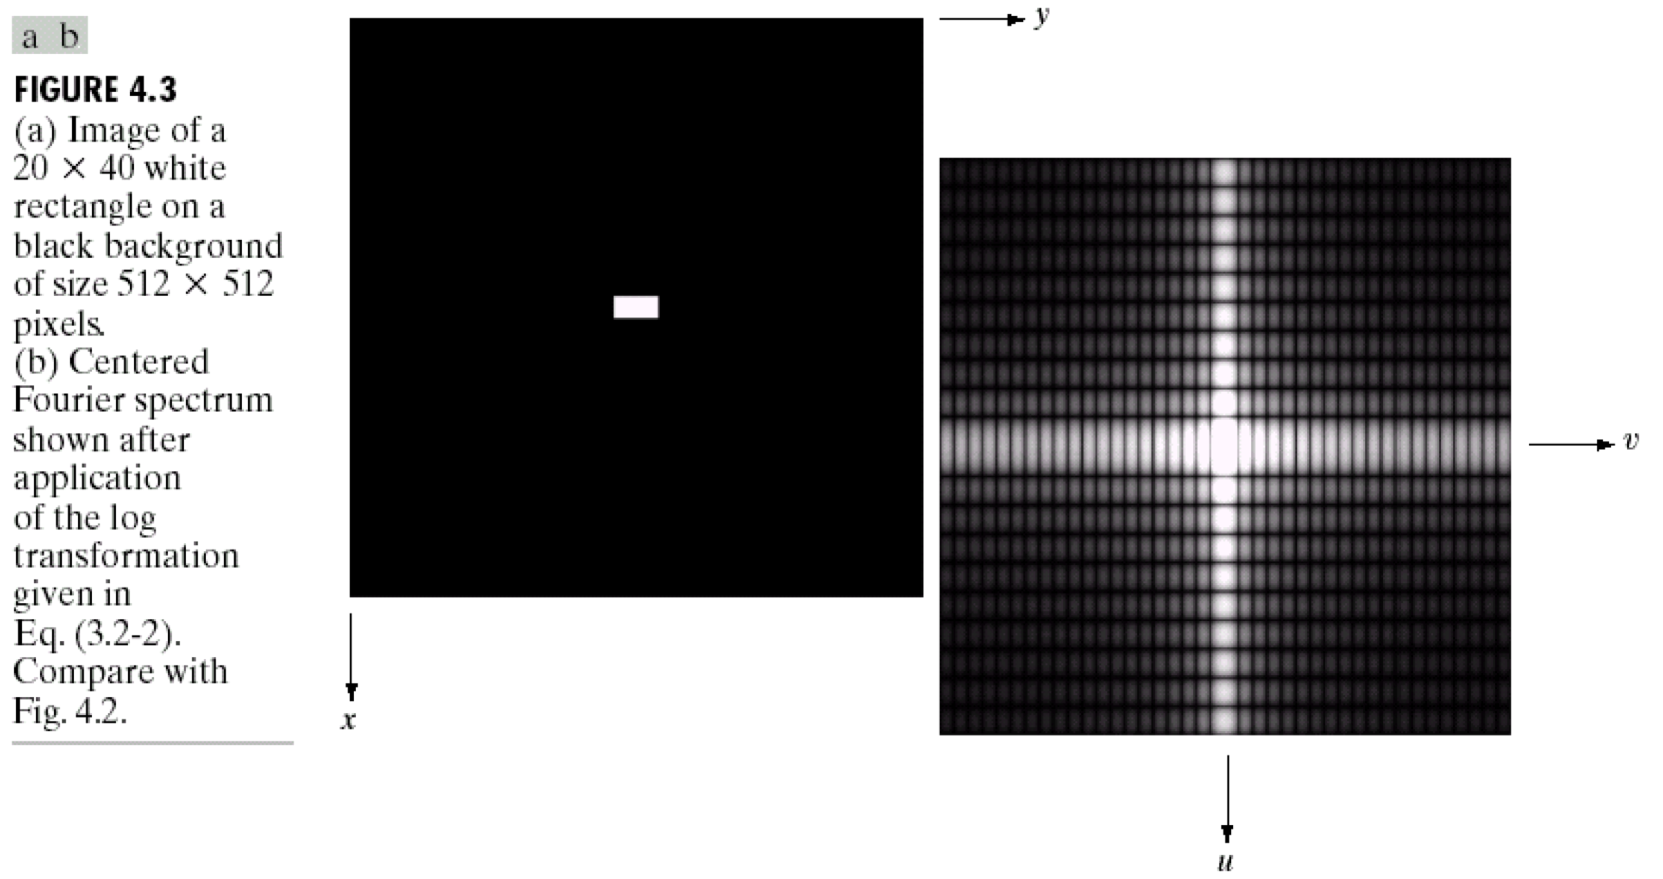
Examples

Slide 33
Another Example
Jean Baptiste
Joseph Fourier
His Fourier Transform

Slide 34
Filtering Images in the Frequency Domain
Just like we can filter 1-D signals, we can also filter 2-D images
  Fourier transform the image
  Multiply by the filter
  Inverse Fourier Transform
Low-pass filtering = blurring
High-pass filtering = edge detection
High-boost filtering = sharpening

Slide 35
A really important detour…

Slide 36
Time Domain vs. Frequency Domain
Time
Domain
What’s the equivalent?
Input
System
Output
Frequency
Domain

Slide 37
The Convolution Theorem
Convolution in one domain is multiplication in the other
and vice versa
  Convolution in the time domain and multiplication in the frequency domain are equivalent
  Multiplying two signals in the time domain convolves their FTs
  (useful for lots of things)
Relationship between convolution kernels and transfer functions?

Slide 38
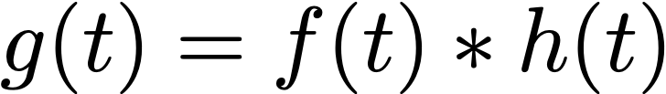
Time Domain vs. Frequency Domain
Time
Domain
Input
System
Output
Frequency
Domain

Slide 39
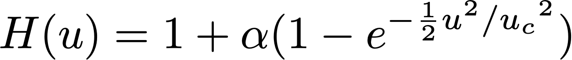
Example: High Boost Filters
Can construct a high-boost filter by
  Low-pass filtering the signal
  Subtracting it from the original
  Adding a fraction of that back to the original
Sound familiar?

Slide 40
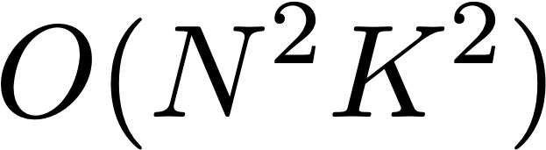
The Need For Speed…
Convolution of an N x N image with a K x K kernel:
FFT the signal, FFT the kernel, inverse FFT:
For large kernels, doing it in the frequency domain can be faster!
General rule of thumb, the break-even point is 7 x 7 kernels

Slide 41
Design vs. Implementation
We can design in either domain
  Spatial filters in (masks or kernels) in the time/spatial domain
  Frequency filters in the frequency domain
And we can implement them in either domain
  Convolution in the time/spatial domain
  Multiplication in the frequency domain

Slide 42
Another important detour…

Slide 43
Linear, Shift-Invariant Systems
What kinds of systems can be modeled this way?
Ones that are
  Linear: if you feed in a weighted sum of inputs, you get a similarly weighted sum of their outputs
  Shift-invariant: doesn’t change behavior over time
In reality, linear, shift-invariant systems don’t really physically exist, but lots of things are “close enough” over some operating range

